Slide 1

Neo4J
The graph database
Student: Bujor Tiberiu-Cosmn
Prof: Dijana Capeska Bogatinoska

Slide 2
Table of contents
What is Neo4j?
How does it work?
Install and setup
Introduction
The hidden powers
Conclusions

Slide 3
What is Neo4j?
Neo4j is the most popular graph database management system. (others – ArangoDB, Ontotext, OrientDB)
Developed by Neo Technology, Inc.
Initial Release - 2007
Last Stable Release - December 9, 2016
It is ACID (Atomicity, Consistency, Isolation, Durability) compliant transactional database with native graph storage and processing.
Has CRUD (create, read, update and delete) operation support.

Slide 4
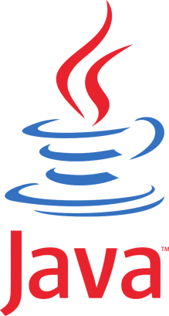


Written in Java
Can be used on any platform (Windows or Unix based)
Comes in two versions:
Community (open source)
Enterprise and Government (paid)
The main difference is that Community can only use one node at a time (lack of clustering )

Slide 5
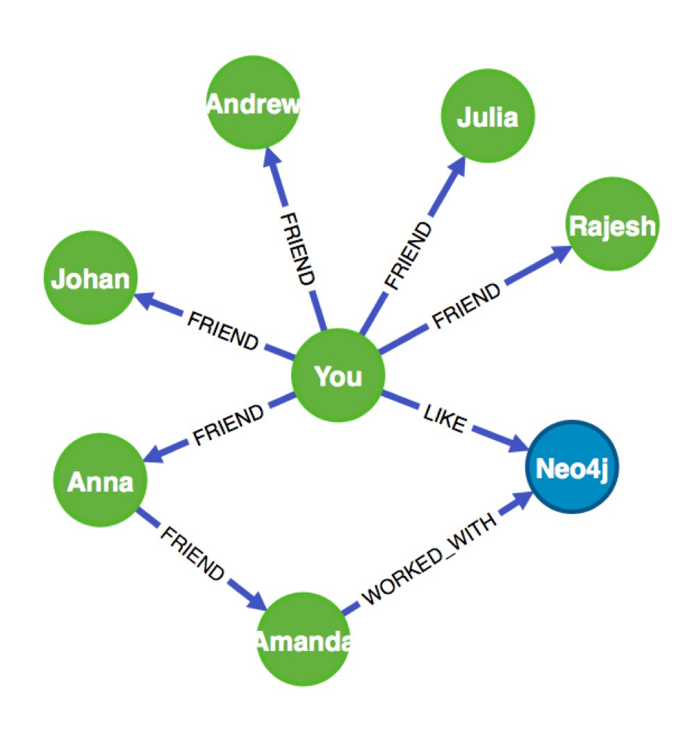
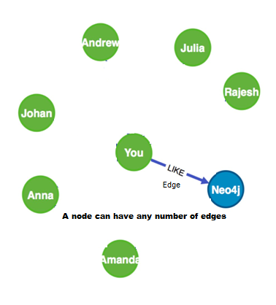
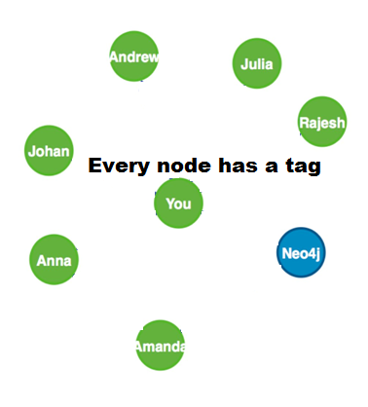
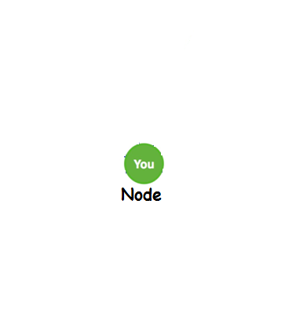
How does it Work?
Neo4j works like any graph database, data being stored as nodes and edges (relationships).
There are several query languages that interoperate with Neo4j: Java code, REST, Gremlin, Cypher, Ruby console, and others. (I am using Cypher)
Cypher is based on pattern matching and a SQL-like syntax. The clauses feel familiar, making it easy to understand what’s going on.
START ice_wine=node(0)
MATCH (ice_wine) -[:grape_type]-> () <-[:grape_type]- (similar)
RETURN similar

Slide 6
Other components of Neo4j:
Cache
Node/Relationship Object cache (use in Traversal)
FS cache (fast navigation of record files)
Traversals
Transactions (Shared)
High Availability (based on Transactions)
Core API

Slide 7
Install and setup
To download Neo4j, open a web browser and access this address: Neo4j community edition. You can chose to download the executable or the zip file.
After you’ve downloaded and unzipped the Neo4j package, open command prompt (cmd) and navigate to the install directory and start up the server with this:
$ bin/neo4j start
To make sure you’re up and running, try curling this URL:
$ curl http://localhost:7474/browse/
The default Neo4j package comes equipped with a substantial web administration tool and data browser.
If you installed the executable, open with neo4j-ce.exe in "C:\Program Files\Neo4j CE 3.1.3\bin"

Slide 8
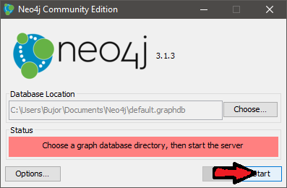
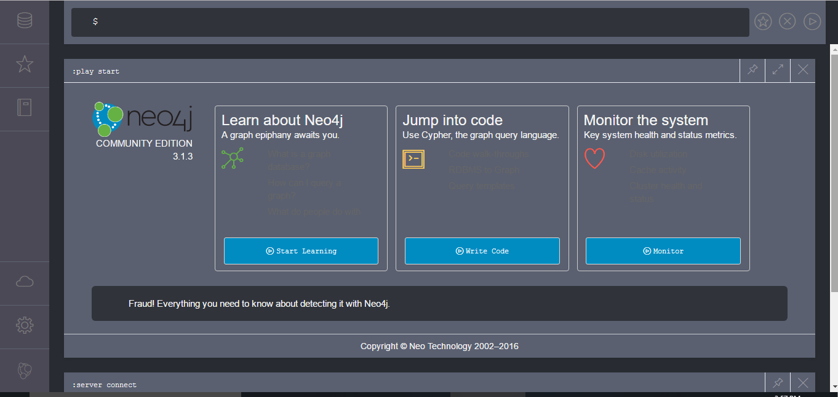
Browser Console
Server
The interface is user-friendly and can be used for learning, creating and monitoring graph databases.
To create a new graph database, change the directory of “Database Location” and press start.
To delete a graph database:
Console: rm -rf data/*
File: remove the directory
The keyword “create” is used to make new nodes and relationships.
The keyword “match” is used for searching.

Slide 9
Introduction
Graph databases are based on graph theory, and employ nodes, edges, and properties.
Nodes represent entities such as people, businesses, accounts, or any other item to be tracked. They are roughly the equivalent of the record in a relational database, or the document in a document database.
Edges, also termed graphs or relationships, are the lines that connect nodes to other nodes; they represent the relationship between.
Properties are germane information that relate to nodes.

Slide 10
Introduction
Compared with relational databases, graph databases are faster for associative data sets and map more directly to the structure of object-oriented applications.
They can scale more naturally to large data sets as they do not typically need costly join operations.
They depend less on a rigid schema and are more suitable to manage ad hoc and changing data with evolving schemas.
Graph databases are a powerful tool for graph-like queries.

Slide 11
The hidden Powers
Graph Search makes interaction with a machine possible without having to go in-depth with advanced knowledge.
A user types what they are looking for in their own words. Their words are parsed in context and compared against a grammar of relationships the system understands.
Once the system understands the question, it finds the answers by combining relationships to find paths from the user to the subject in question.
Finally the answers are displayed with some hint of how the system connected the paths.

Slide 12
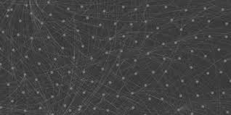
The hidden Powers
Deep Learning Sentiment Analysis is often implemented with a Neo4J database.
Graph databases enable efficient storage and traversal of information between relationships.
Graph data can either be the input or the output of machine learning processing.

Slide 13
CONCLUSIONS
World’s Best and First Graph Database.
Easy to setup and use.
Easy to learn (Cypher is the most intuitive graph query language).
It’s good for Start-ups where data input can be handled with a few nodes.
The Graph community revolves around Neo4j.
Neo4j is highly maintained and new versions appear every 6 months.

Slide 14
References
Silberschatz, Avi (28 January 2010). Database System Concepts, Sixth Edition
Fowler, Adam (February 24, 2015). NoSQL for Dummies
"Examples where Graph databases shine: Neo4j edition"
Svensson, Johan (5 July 2016). "Guest View: Relational vs. graph databases: Which to use and when?
https://neo4j.com/graphacademy/

